Slide 1

Casebook
Supervisor
Ma’am Kiran Amjad Butt
Submitted by
Muhammad Ahmad
{Fa-17-BSSE-168}
Muhammad Faraz Khalil Mughal
{Fa-17-BSSE-158}
Department of Software Engineering
Lahore Garrison University

Slide 2
Outline
Lawyer Signup
Client Signup
Lawyer Login
Client Login
Case Updates without Authorization
Case Management
Client Management
Court Management
Case Events
Reminders
Document Scanner
Emails
Sms
Department of Software Engineering
Lahore Garrison University

Slide 3
Introduction
Casebook is a mobile application based portal for lawyers and clients, to provide better communication between the two and to make the court process efficient. Lawyers wont have to deal with the manual filesystem. Clients will be completely updated with their cases, app will be covering cases repository, client management, courts management, emails, sms, cases reminders, adjourned dates and authorization.
The app will be cross-platform working on both android and ios operating systems. The development is in React Native. It is a library of javascript to create dynamic interactive cross-platform mobile apps. The backend and database will be Fireba
Department of Software Engineering
Lahore Garrison University

Slide 4
Objectives
Casebook has the following functions:-
Lawyer Signup
Client Signup
Lawyer Login
Client Login
Case Updates without Authorization
Case Management
Department of Software Engineering
Lahore Garrison University

Slide 5
Problem Statement
Right now our judicial system is based on the manual filing system, we are initiating a step toward digitalizing it, right now we are offering a solution for lawyers through our app. The Lawyers can easily manage all their cases in a smart way. They can keep their clients updated. In their current approach they need to keep track of all their files and documents which can get a bit messed up or the could lose sensitive information about their cases. And on the other hand clients also faces difficulty on keeping up with progress of their cases.
Department of Software Engineering
Lahore Garrison University

Slide 6
Proposed Solution
We are saving customer’s time by our app.
Book customer’s appointment.
We made app which will work on all operating system.
Register any Client in our app.
Lawyers can stay up to date on their schedule.
All the Data and documents are manged by the apps.
Clients stay in touch and up to dated.
Cases notes will be paper less
All dates are synced with phone calendar
Clients can stay in touch without making an account.
Document Scanning and saving.
Email & SMS Updates
Department of Software Engineering
Lahore Garrison University

Slide 7
Methodology
React native, expo-cli.
Firebase.
Firebase auth.
React Native elements.
React Navigations , Stack Navigation
Node JS
Express Js
Postrace SQL
Department of Software Engineering
Lahore Garrison University

Slide 8
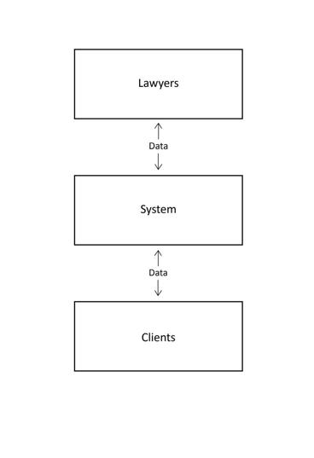
Flow Chart
Department of Software Engineering
Lahore Garrison University

Slide 9
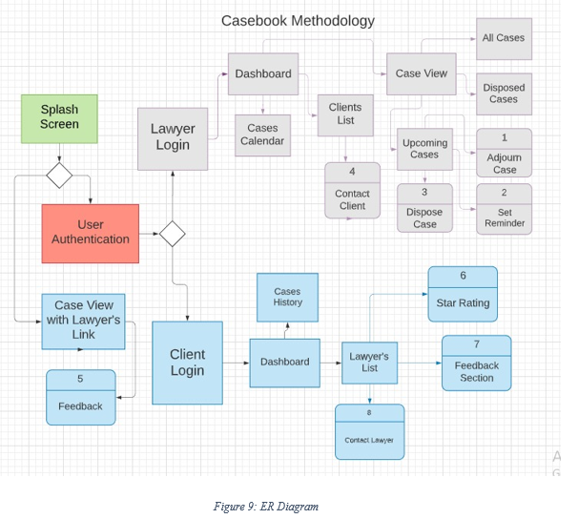
ER diagram
Department of Software Engineering
Lahore Garrison University

Slide 10
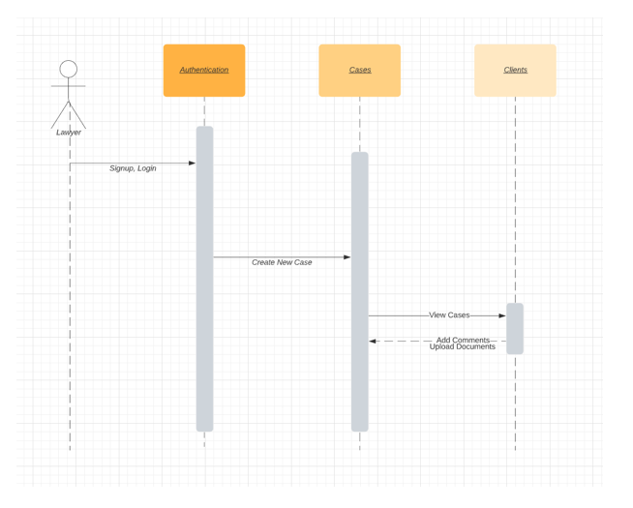
Sequence Diagram
Department of Software Engineering
Lahore Garrison University

Slide 11
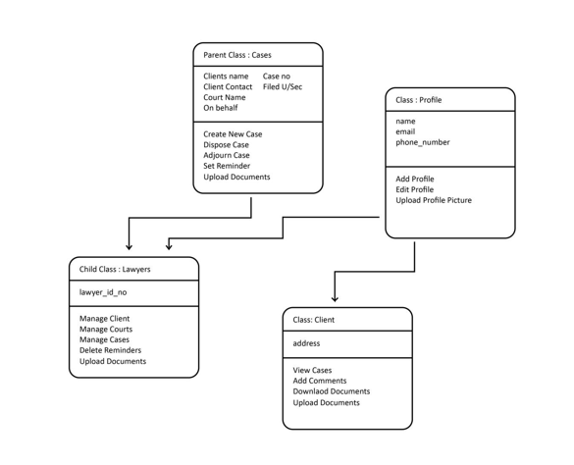
Class Diagram
Department of Software Engineering
Lahore Garrison University

Slide 12
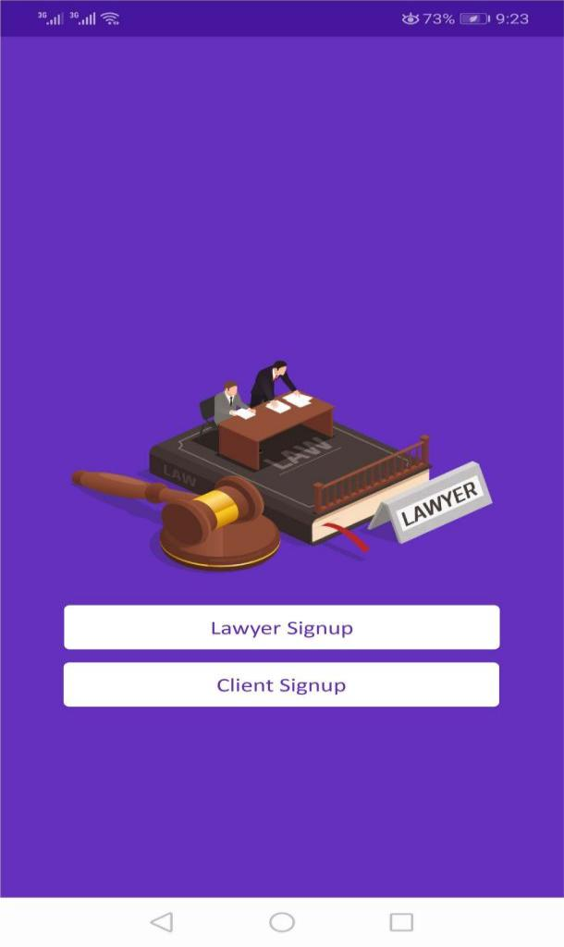
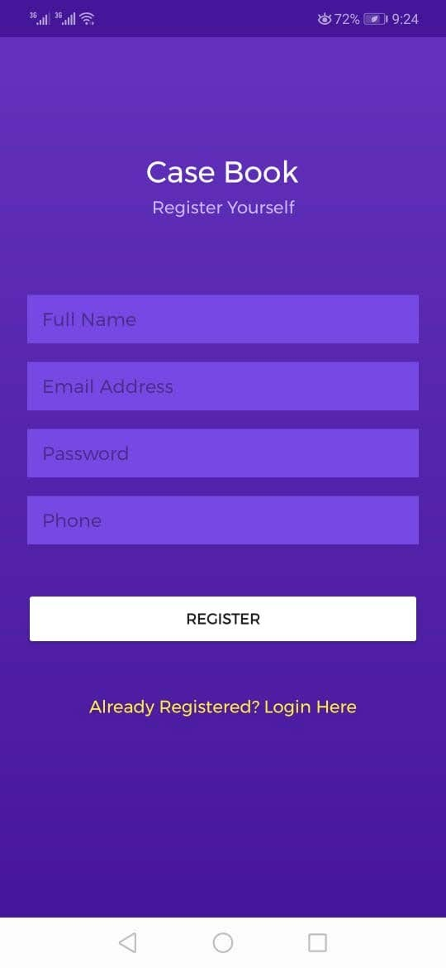
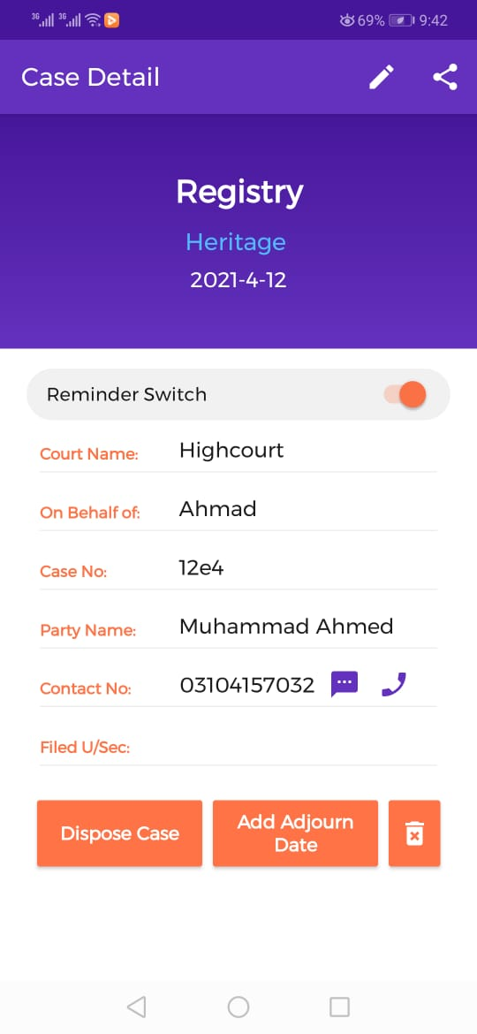
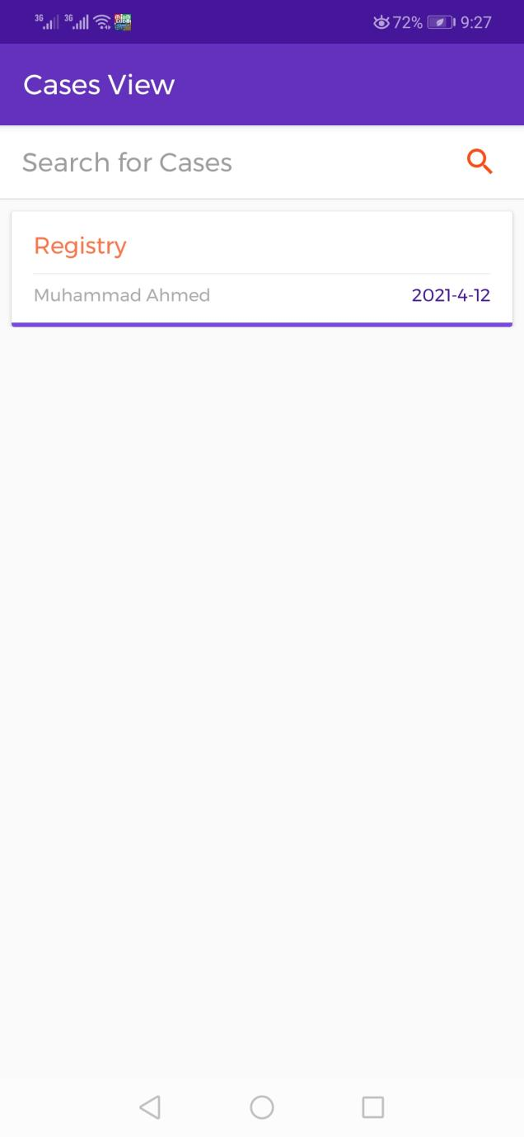
User Interface
Department of Software Engineering
Lahore Garrison University

Slide 13
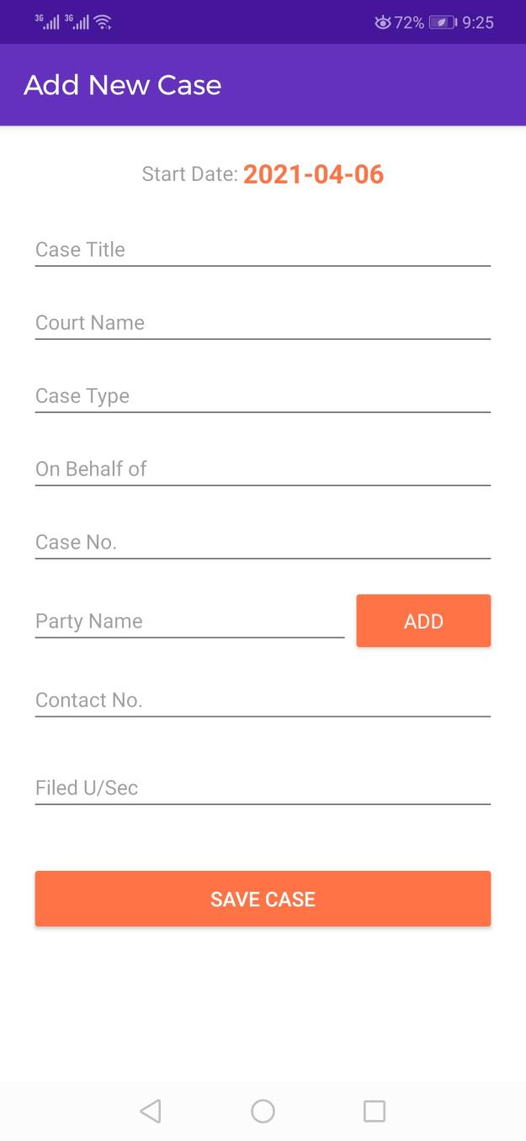
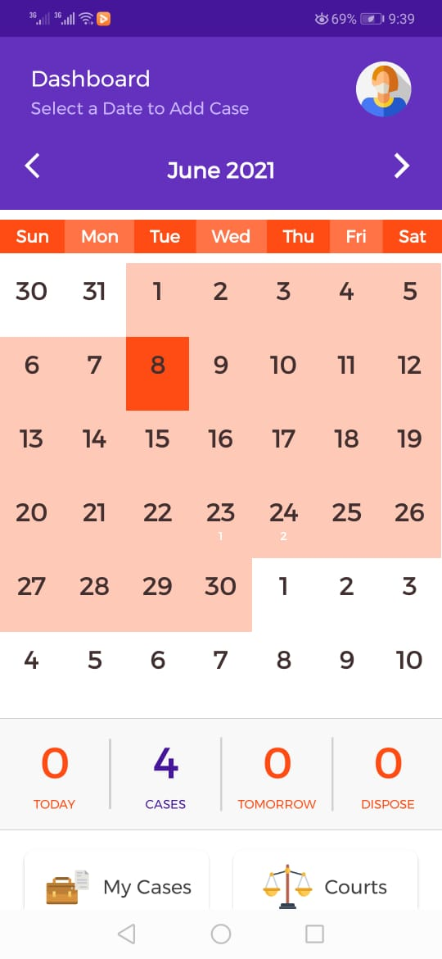

Slide 14
Questions?
Any Questions?????????????????
Department of Software Engineering
Lahore Garrison University

